Slide 1

Dynamic AI Traffic Light System
By:- Analytic Avengers
Team Members:-
Kunal Dhand
Aditya Thakur
Shashank Gulati
Ayush Munot
Lakshay Tyagi
Ritesh Mohanty

Slide 2
IIntroduction
1
Introduction
2
Working of AI Traffic System
3
Benefits
Contents
4
Business Model
5
References

Slide 3
Dynamic AI Traffic Light System
Traffic congestion is a major problem that affects people's daily lives. One of the factors that contribute to congestion is the timing system of traffic lights. Congestion can cause increased fuel consumption, air pollution, wasted time and energy, and pavement damage. A potential solution to this problem is to implement an AI traffic system that dynamically adjusts the timing of traffic lights based on the volume of traffic.
A dynamic AI traffic light system is a traffic management system that uses artificial intelligence (AI) and real-time data to adjust the timing of traffic lights based on the volume of traffic. By dynamically adjusting traffic light timings, the system can reduce congestion and travel times, improve air quality, and reduce fuel consumption and vehicle wear and tear.
01
INTRODUCTION

Slide 4
How does AI Traffic System work?
The AI system collects real-time data on traffic time using sensors and cameras.
The data is then processed using machine learning algorithm to predict traffic flow and optimize the timing of traffic lights accordingly.
The system can also adapt to changing traffic patterns over time to continually improve traffic flow.
02
WORKING

Slide 5
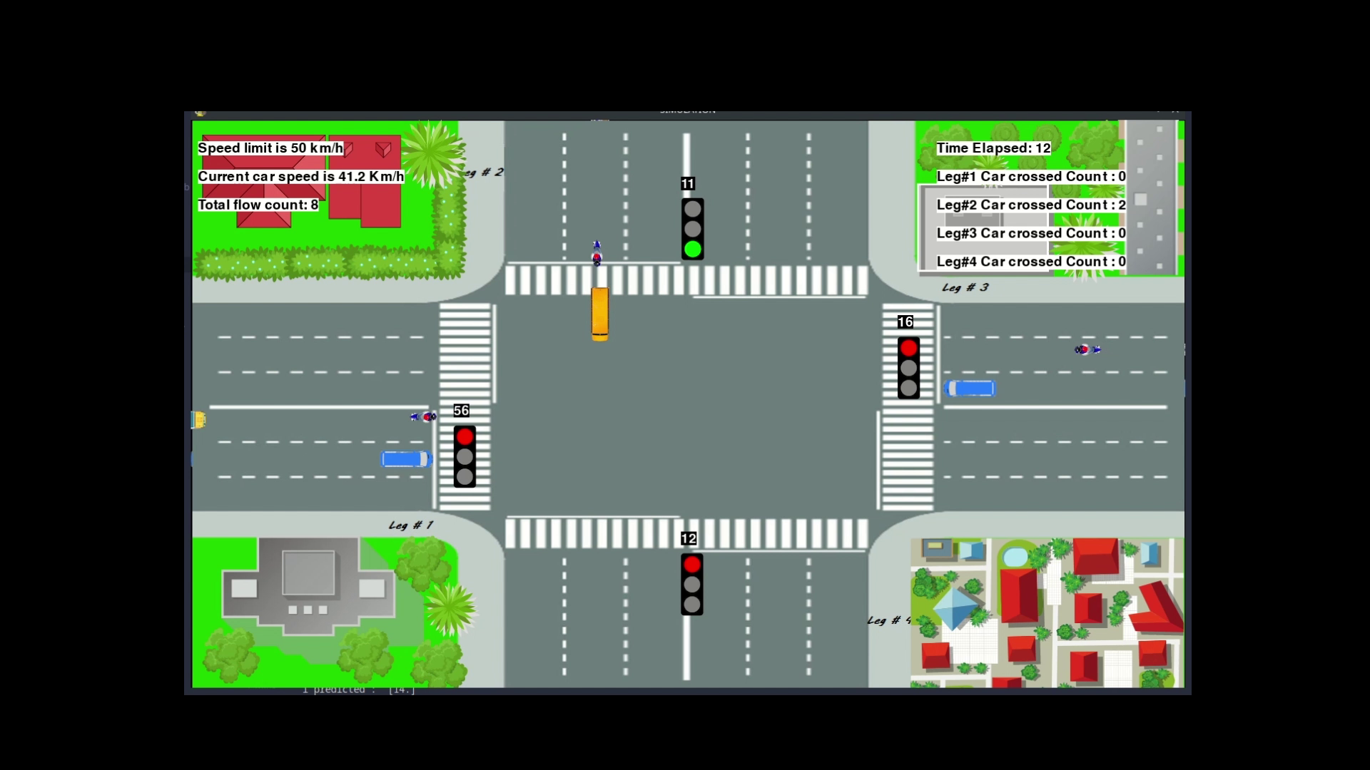

Slide 6
Benefits of AI Traffic System
Reduced congestion: By optimizing traffic light timing based on traffic volume, the system can reduce congestion and travel times.
Improved air quality: Reduced congestion leads to fewer cars idling and emitting pollutants, resulting in improved air quality.
Cost savings: Improved traffic flow can lead to fuel savings and reduced vehicle wear and tear.
Improved safety: Reduced congestion can lead to fewer accidents caused by frustrated drivers
03
BENEFITS

Slide 7
Mission Statement: Our mission is to provide efficient and sustainable traffic management solutions using artificial intelligence (AI) technology to optimize traffic flow and reduce congestion, leading to cost savings, improved air quality, and increased safety on the roads.
Key Activities:
Develop and implement AI-powered traffic management systems that collect real-time data from cameras, sensors, and traffic management centers.
Use machine learning algorithms to predict traffic patterns and optimize traffic light timings to reduce congestion, travel times, fuel consumption, and vehicle wear and tear.
Provide ongoing maintenance and support for our systems to ensure their optimal performance.
Collaborate with local governments, transportation authorities, and businesses to customize our solutions to their unique traffic management needs.
Conduct ongoing research and development to improve our technologies and stay ahead of emerging trends in traffic management.
04
BUSINESS MODEL

Slide 8
Revenue Streams:
Sales of AI traffic management systems to local governments, transportation authorities, and businesses.
Maintenance and support services for our systems.
Data analytics and insights services to help our clients optimize their traffic management strategies.
Key Resources:
Skilled engineers, data scientists, and software developers to design, build, and maintain our AI traffic management systems.
Robust data collection and analysis infrastructure.
Strong partnerships with transportation authorities, local governments, and businesses to collaborate on research and development, as well as customization and implementation of our solutions.

Slide 9
Key Partners:
Transportation authorities, local governments, and businesses to collaborate on research and development, as well as customization and implementation of our solutions.
Hardware and software vendors to provide the necessary infrastructure for our systems.
Data analytics and insights providers to help us generate meaningful insights from the traffic data collected by our systems.
Key Metrics:
Reduction in travel times and congestion in areas where our systems are implemented.
Increased safety on the roads, measured by the number of accidents and traffic violations reported.
Cost savings for our clients resulting from optimized traffic management strategies.
Improved air quality, measured by reductions in air pollutants in areas where our systems are implemented.

Slide 10
Conclusion:-
Our business model focuses on providing AI-powered traffic management solutions that optimize traffic flow, reduce congestion, improve air quality, and increase safety on the roads. By partnering with local governments, transportation authorities, and businesses, we aim to customize our solutions to their unique traffic management needs, while also conducting ongoing research and development to stay ahead of emerging trends in traffic management. Our revenue streams include sales of AI traffic management systems, maintenance and support services, and data analytics and insights services. Our success will be measured by reductions in travel times and congestion, increased safety on the roads, cost savings for our clients, and improved air quality.

Slide 11
References
Google
https://www.google.com/
Kaggle
https://www.kaggle.com/
Youtube
https://www.youtube.com/
OpenCV
https://opencv.org/
Python Documentation
https://docs.python.org/3/
ChatGPT
https://openai.com/blog/chatgpt
05
REFERENCES

Slide 12
Thank You
By:- Analytic Avengers

